Slide 1

H2 In-Memory Database
H2 In-Memory database very easy to setup and very easy to use.
We can insert and delete from the H2 In-Memory database as many times we want and it will not impact
the team members and will not impact the Real-time database which is used by other team members
All the data which are stored in-memory database stays in memory and it is cleared out once you stop the
Application and when we start the application there won’t be any data in the in-memory database and we can start
From scratch.
H2 Database is java sql database, and light weight and we can quickly integrate with Spring boot project.
Real-time database and it is used by other team members and we should not corrupt with test data
MySQL
Spring Boot Application
H2

Slide 2
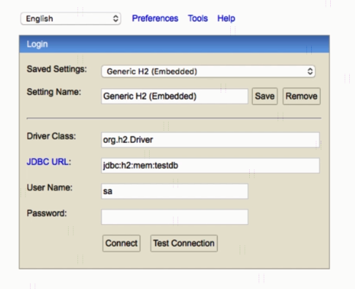
H2 In-Memory Database

Slide 3
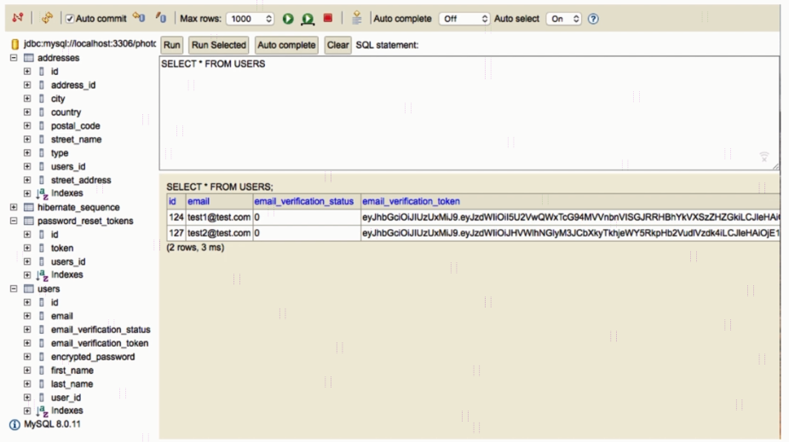
H2 In-Memory Database

Slide 4
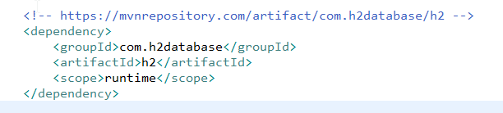
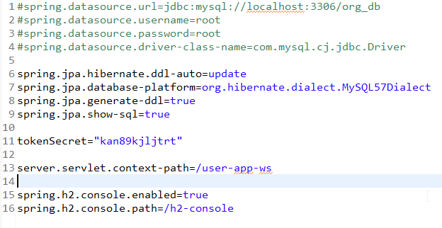
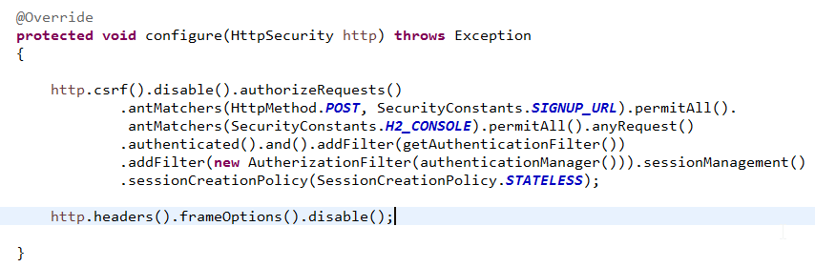
Sign in to H2 In-Memory Database
http://localhost:8080/user-app-ws/h2-console

